Slide 1
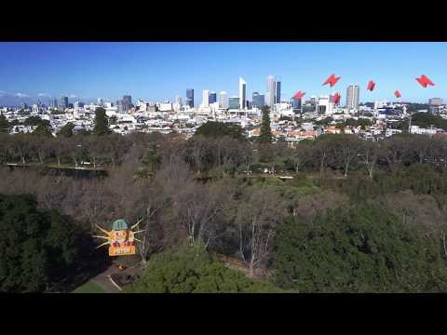
https://www.youtube.com/watch?v=tb-AI5zVV-A

Slide 2
Units of Energy – Watts, Kilowatts, and Kilowatt Hours
Miss Lum
Year 11 Essentials

Slide 3
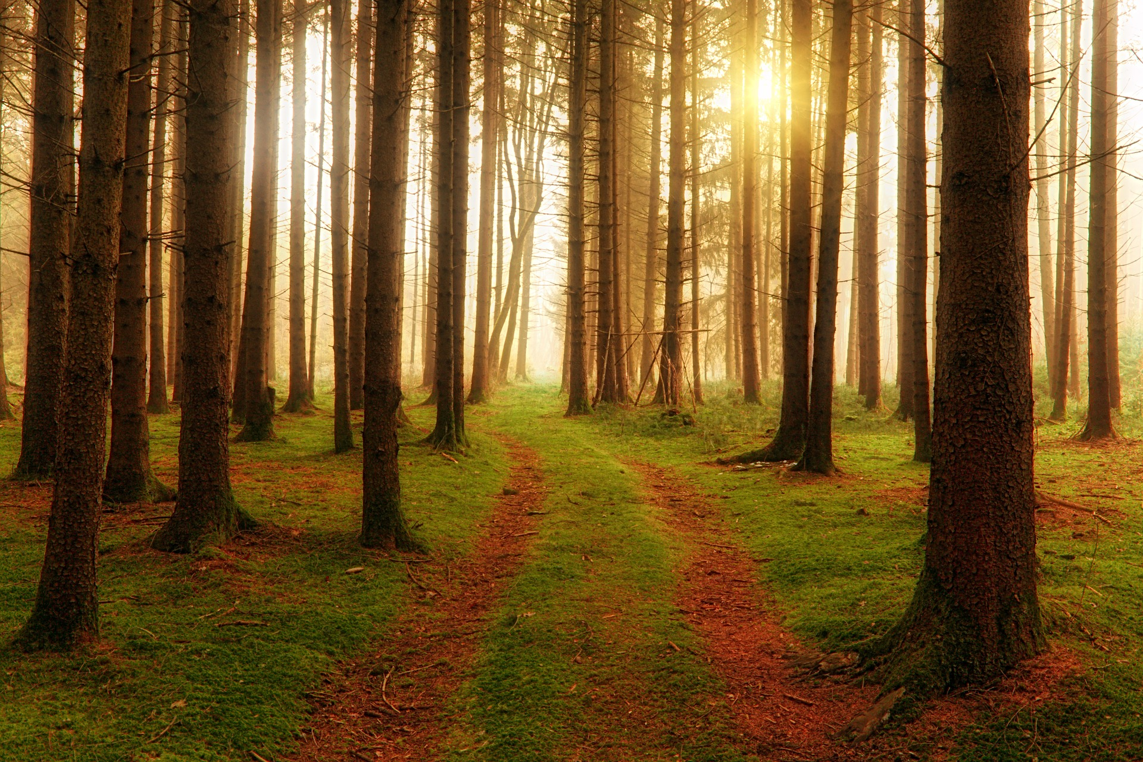
Learning Outcomes
Dot Points
1.3.15 Use units of energy to describe consumption of electricity, such as kilowatt hours
Contexts
Compare energy used for operating different appliances for given times

Slide 4
24
7
30
Units of Energy
Date: 01/04/2018
EQ – What are the Units of Energy?
How is energy used in electricity measured?
The energy used to run electrical appliances is measured in watts or kilowatts.
An electricity account measures kilowatt hours.
Examples:
A heater rated at 1 kilowatt or 1000 watts means that when it is in use for one hour, 1 kilowatt of energy will be used.
A 40 watt light globe uses 0.04 kilowatt hours of energy per hour
1 kilowatt = 1kW = 1000 watts
1 kilowatt hour = 1kWh (A unit of energy equivalent to 1kW of power used in one hour)
What is a kilowatt hour?

Slide 5
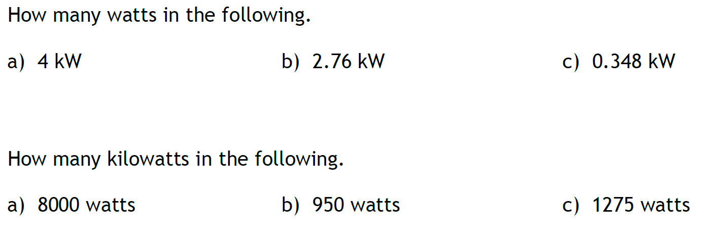
Guided Practice
4000 W
2760 W
348 W
8 kW
0.95 kW
1.275 kW

Slide 6
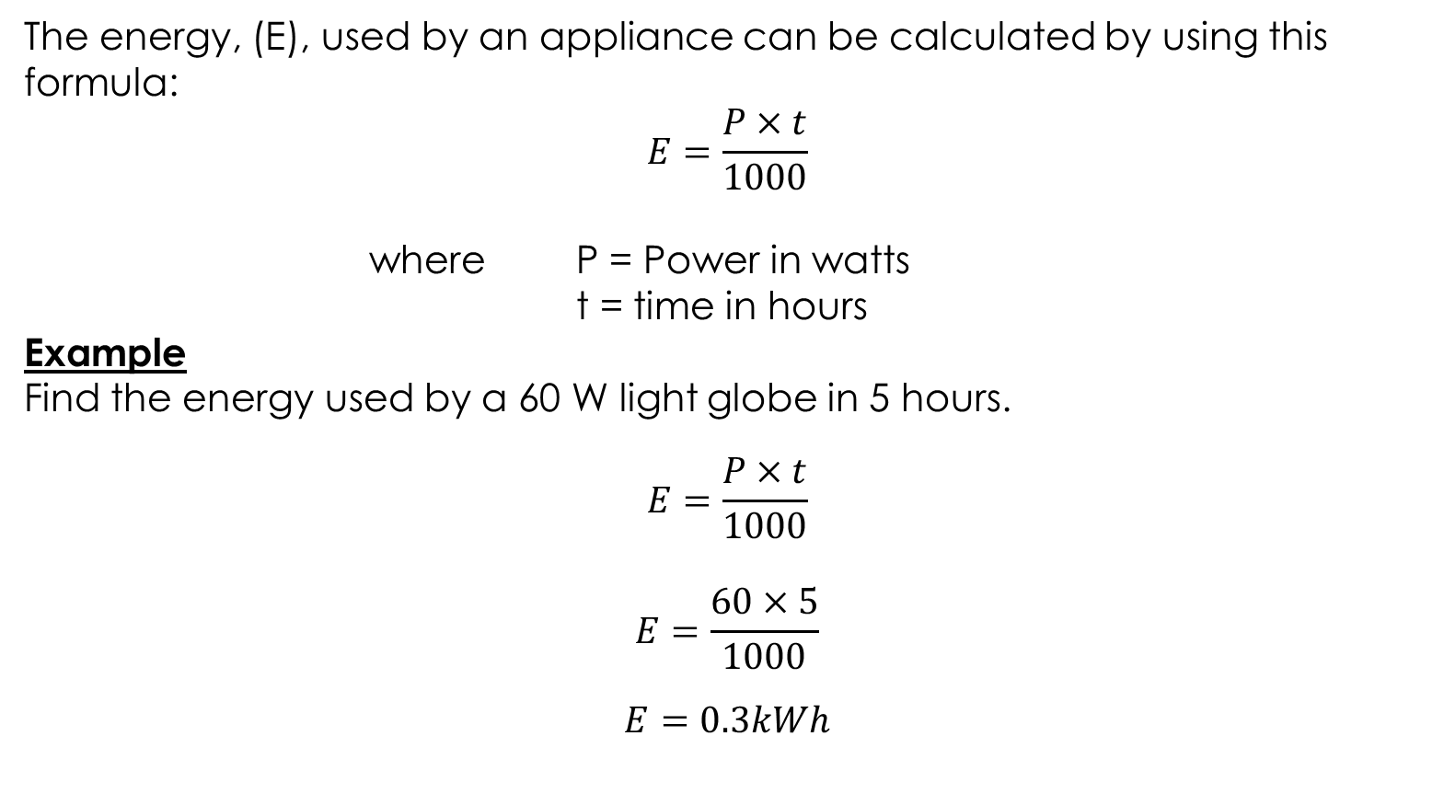
24
7
30
Units of Energy
Date: 04/05/2018
EQ – How do we calculate the energy used by electrical appliances?
What is the formula for calculating Energy used by appliances?
The energy, (E), used by an appliance can be calculated by using this formula:
$$E=\frac{P×t}{1000}$$
where P = Power in watts
t = time in hours
Example
Find the energy used by a 60 W light globe in 5 hours.
$$E=\frac{P×t}{1000}$$
$$E=\frac{60×5}{1000}$$
$$E=0.3kWh$$
How do we use the formula to calculate energy?

Slide 7

24
7
30
Units of Energy
Date: 04/05/2018
EQ – How do we calculate the energy used by electrical appliances?
The energy, (E), used by an appliance can be calculated by using this formula:
$$E=\frac{P×t}{1000}$$
where P = Power in watts
t = time in hours
Example
Find the energy used by a 6kW heater that is used for 4 hours and 15 minutes to heat a room.
$$E=P×t$$
$$E=6×4.25$$
$E=25.5$ kWh
How do we use the formula to calculate energy?
How do we calculate Energy when we have kW?

Slide 8
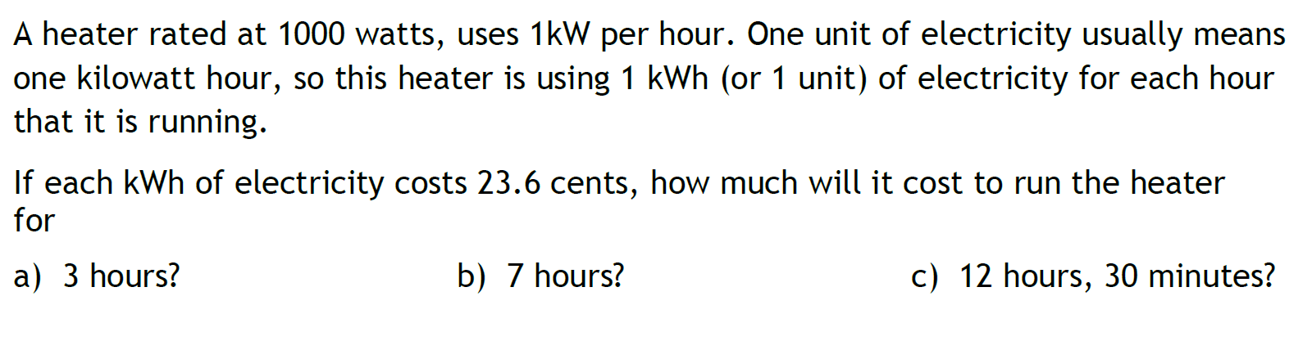
Task

Slide 9
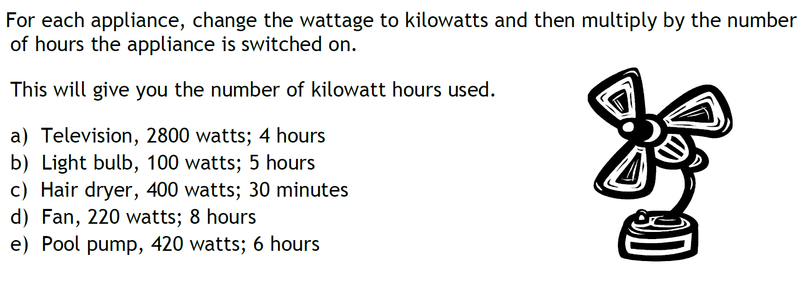
Task

Slide 10
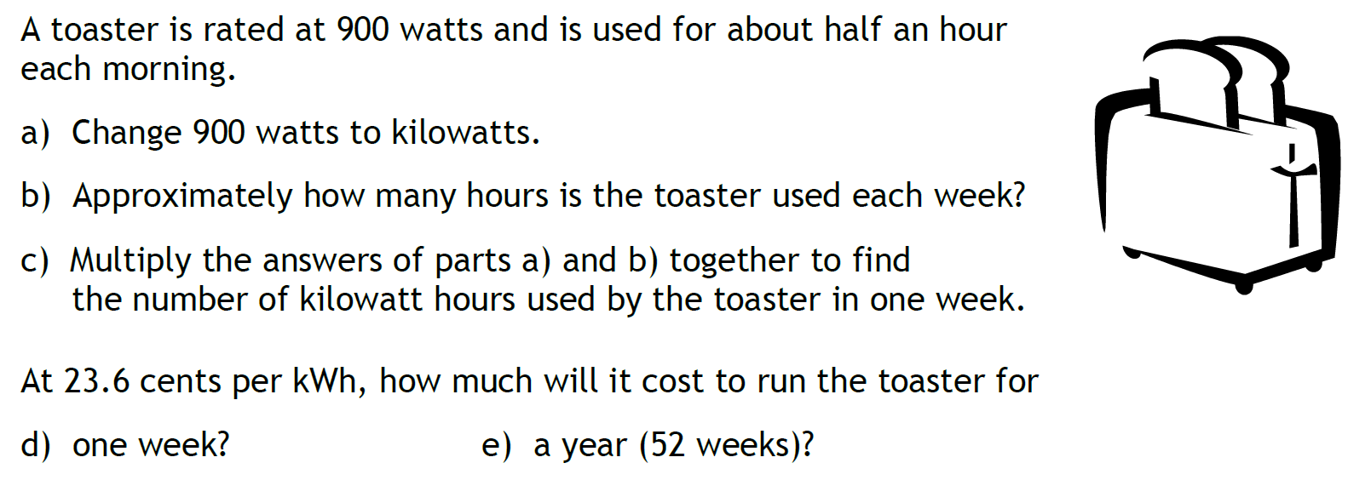
Task

Slide 11
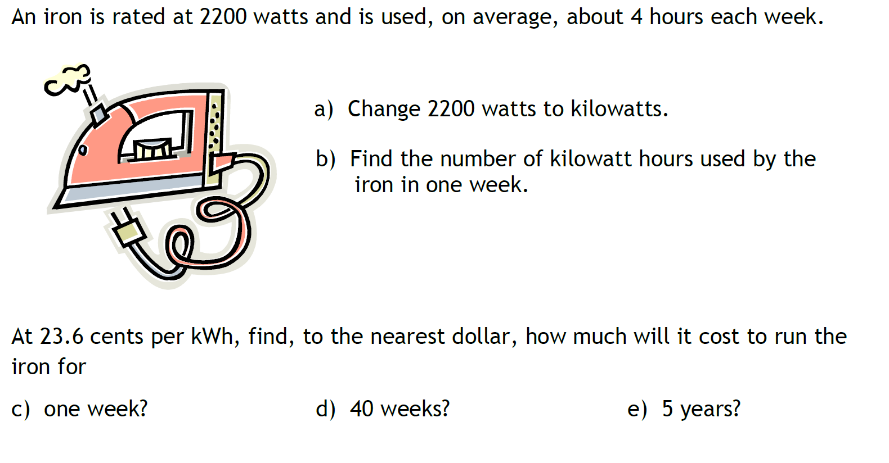
Task

Slide 12
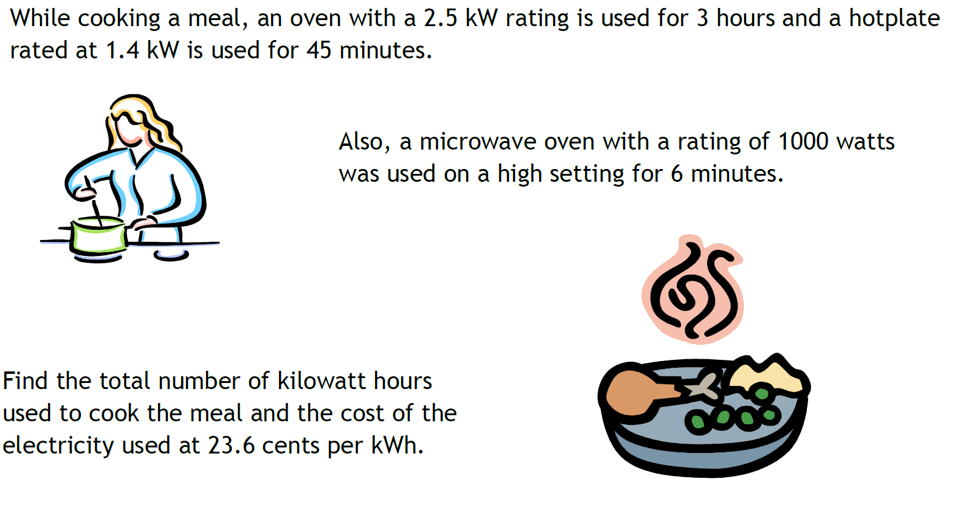
Task

